Slide 1
Chapter 14. Time series models 3
Financial Econometrics
Department of financial engineering
Zhongnan university of economics and law
Xu Yonghao

Slide 2
oUTLINE
Volatility
Case Study
ARCH-family
ARCH

Slide 3
1. Volatility
Return Volatility
Volatility is a statistical measure of the dispersion of returns for a given security or market index. In most cases, the higher the volatility, the riskier the security. Volatility is often measured as either the standard deviation or variance between returns from that same security or market index.
Idiosyncratic
Volatility
Based on asset-pricing models, idiosyncratic volatility measures the part of the variation in returns that cannot be explained by the particular asset-pricing model used.
Implied Volatility
Implied volatility is the market's forecast of a likely movement in a security's price. It is a metric used by investors to estimate future fluctuations (volatility) of a security's price based on certain predictive factors.

Slide 4
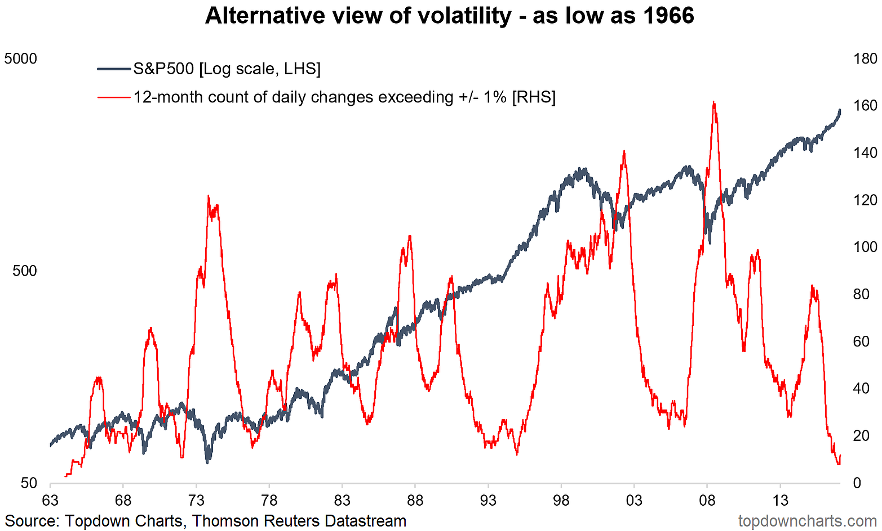
1.1 Return Volatility
Notes:
https://seekingalpha.com/article/4143213-return-of-volatility。 From seeking alpha

Slide 5
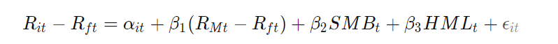
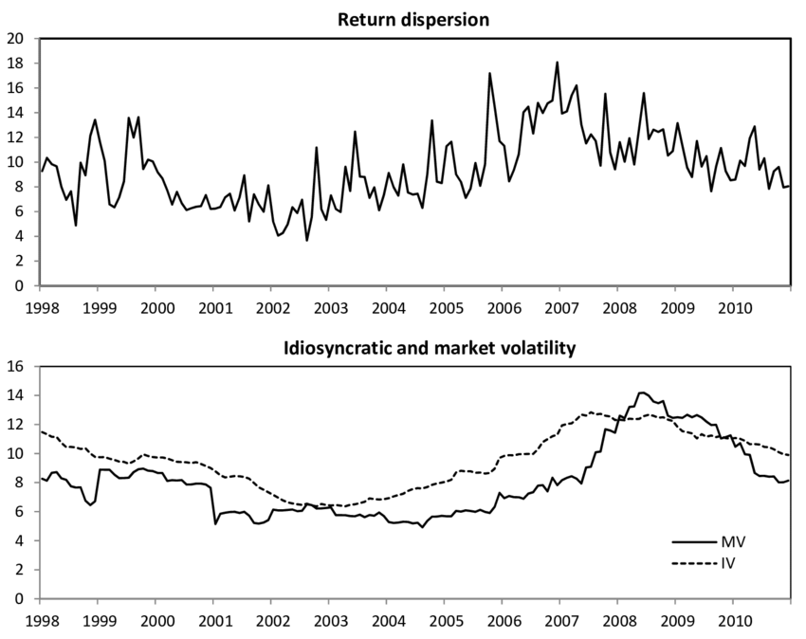
1.2 Idiosyncratic Volatility
Notes:
https://www.researchgate.net/figure/Return-dispersion-idiosyncratic-volatility-and-market-volatility_fig1_258334027 ; from Riza Demirer

Slide 6
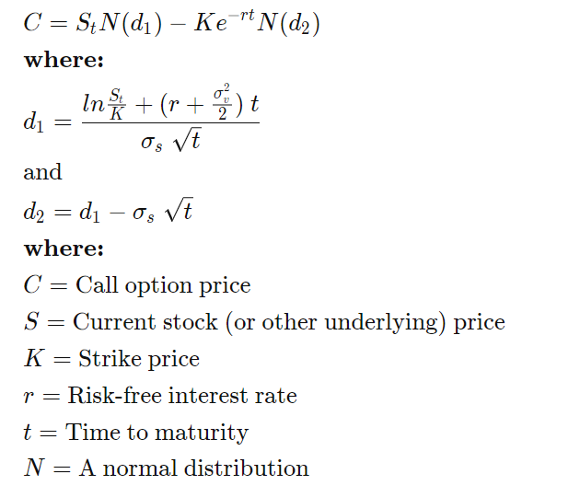
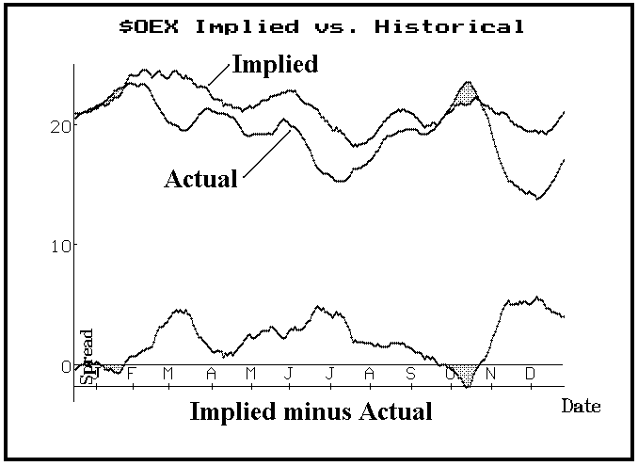
1.3 Implied Volatility
Notes:
From https://www.optionstrategist.com/blog/2019/07/implied-volatility-good-predictor-actual-volatility-0902; By Lawrence G. McMillan,大佬的

Slide 7
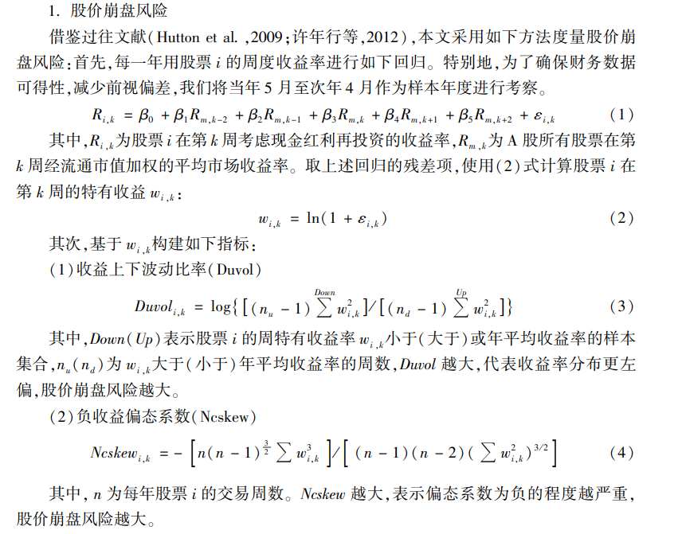
1.4 Tail Risk

Slide 8
oUTLINE
Volatility
Case Study
ARCH-family
ARCH

Slide 9
2.1 Equity Premium & Volatility puzzle
While the models of Rietz (1988) and Barro (2006) advance our understanding of the equity premium, they fall short in other respects. Most importantly, these models predict that the volatility of stock market returns equals the volatility of dividends.
Numerous studies have shown, however, that this is not the case. In fact, there is excess stock market volatility; the volatility of stock returns far exceeds that of dividends (e.g. Shiller (1981), LeRoy and Porter (1981), Keim and Stambaugh (1986), Campbell and Shiller (1988), Cochrane (1992), Hodrick (1992)).
-- Wachter (2013)

Slide 10
2.2 What determines the volatility?
Past Vol
Turnover
Profitability
Debt
Asset
Innovation
Trading Cost

Slide 11
2.3 The impacts of volatility
Return (Idiosyncratic Volatility Puzzle)
No relation: A more recent study finding no relation is Bali and Cakici (2008).
Negative relation: Recent empirical research on this topic, beginning notably with Ang et al. (2006), instead tends to find a negative relation between expected return. Also in Chen et al. (2012).
Positive relation: positive relation are provided in, for example, Merton (1987), Barberis and Huang (2001), Malkiel and Xu (2002), and Ewens, Jones, and Rhodes-Kropf (2013).
Option Price

Slide 12
2.4 Individual Investors and Volatility
We show that retail trading activity has a positive effect on the volatility of stock returns, which suggests that retail investors behave as noise traders.
To identify this effect, we use a reform of the French stock market that raises the relative cost of speculative trading for retail investors. The daily return volatility of the stocks affected by the reform falls by 20 basis points (a quarter of the sample standard deviation of the return volatility) relative to other stocks.
For affected stocks, we also find a significant decrease in the magnitude of return reversals and the price impact of trades.

Slide 13
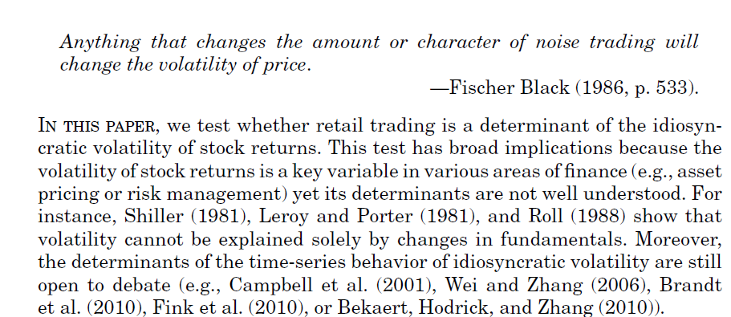
2.4 Individual Investors and Volatility

Slide 14
2.4 Individual Investors and Volatility
核心贡献
whether retail trading is a determinant of the idiosyncratic volatility of stock returns
主要难点（内生性）
Identifying the effect of retail investors on volatility is challenging because retail trading activity in a stock is endogenous and could itself be determined by idiosyncratic volatility.

Slide 15
2.4.1 Institutional Background
Until 2000, each stock listed on Euronext Paris was traded either on a market with end-of-month settlement (the “Reglement Mensuel,” henceforth the RM) or on a market with a fixed settlement lag of 5 business days (the “March´e au Comptant,” that is, the spot market).
Stocks traded on the RM were not simultaneously traded on the spot market. The monthly settlement procedure was suppressed and replaced by the fixed settlement lag procedure on September 25, 2000 to align the organization of Euronext Paris with other equity markets.
Thus, since this date, all stocks listed on Euronext trade only on the spot market.

Slide 16
2.4.2 Hypothesis
The volatility of returns for stocks listed on the RM declines after the reform.
The auto-covariance of stock returns for stocks listed on the RM is smaller (in absolute value) after the reform
The price impact of retail trades for stocks listed on the RM declines after the reform.

Slide 17
2.4.2 Hypothesis
Volatility1 is the monthly standard deviation of daily raw returns.
Volatility2 is the monthly standard deviation of the daily difference between the raw return and the market return.
Volatility 3 is the monthly standard deviation of the residual of the time series regression of the daily excess return for a stock on the daily excess market return.

Slide 18
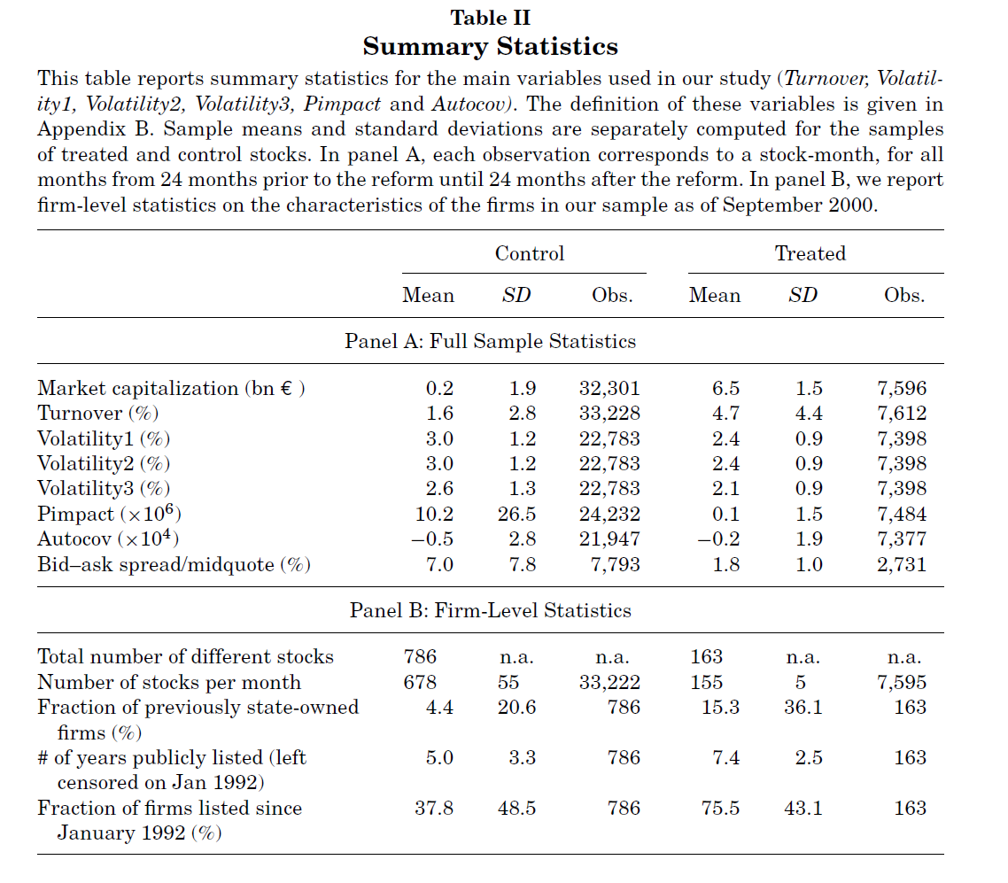
2.4.3 Summary Statistics

Slide 19
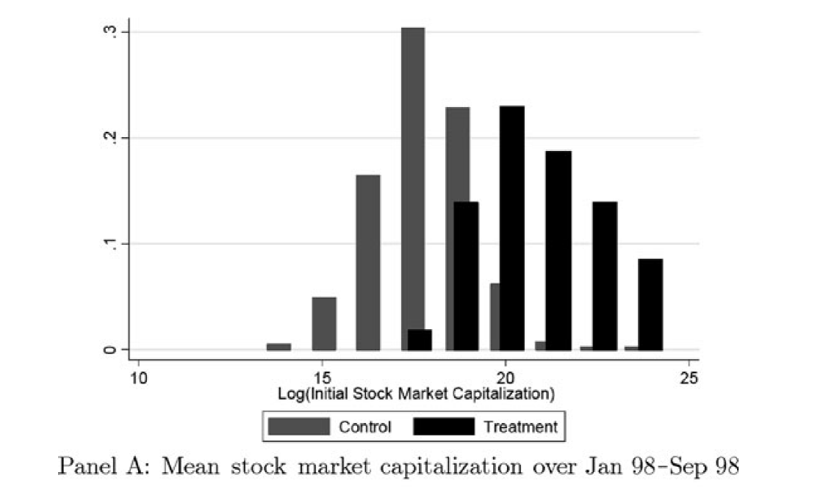
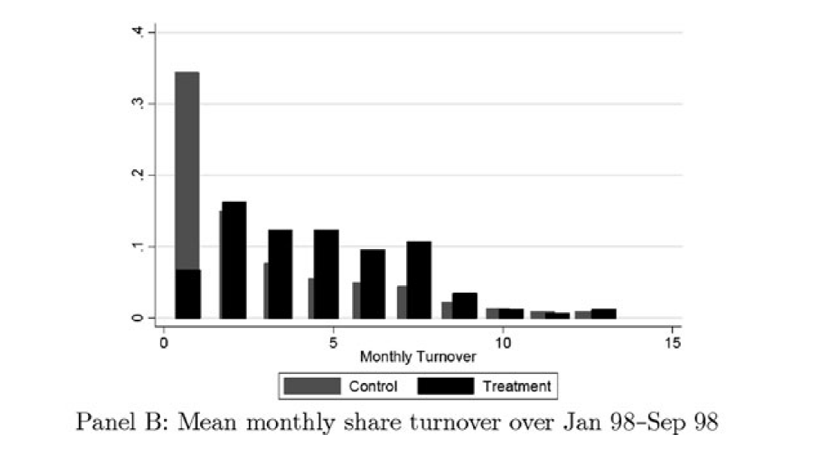
2.4.3 Summary Statistics

Slide 20
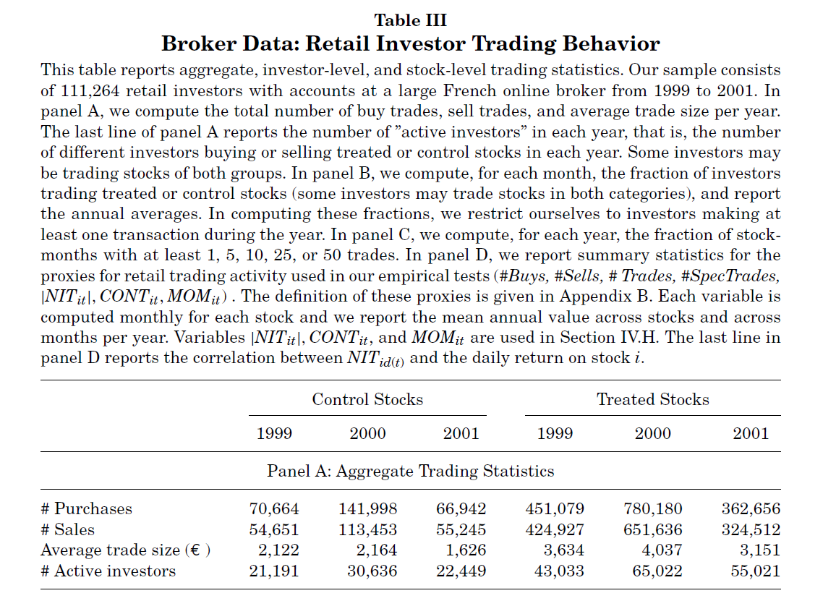
2.4.3 Summary Statistics

Slide 21
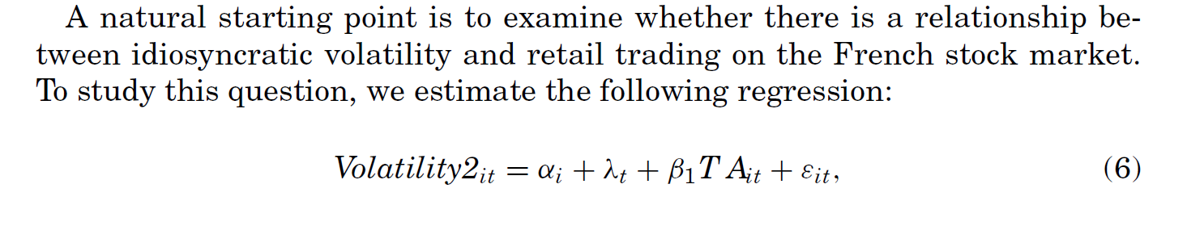
2.4.4.1 Empirical Tests – Simple OLS

Slide 22
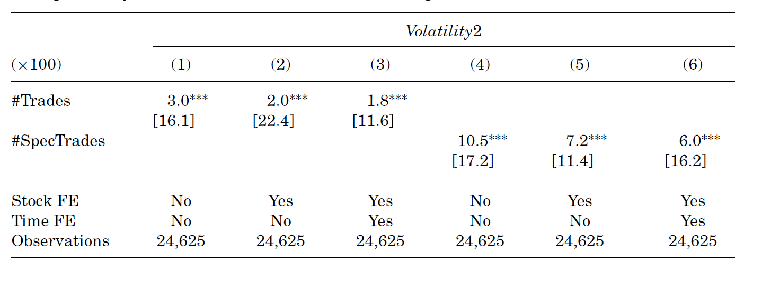
2.4.4.1 Simple OLS

Slide 23
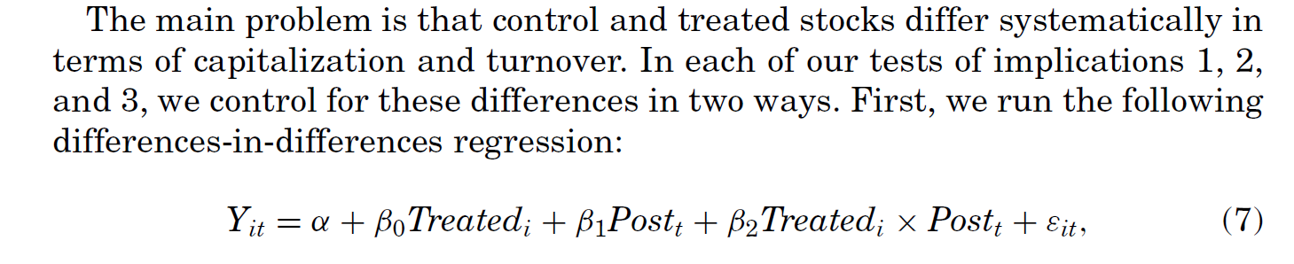
2.4.4.2 Dif in Dif
Notes:
参考 https://www3.nd.edu/~nmark/FinancialEconometrics/Lecture%20Slides/SlidesFall2020_16.pdf

Slide 24
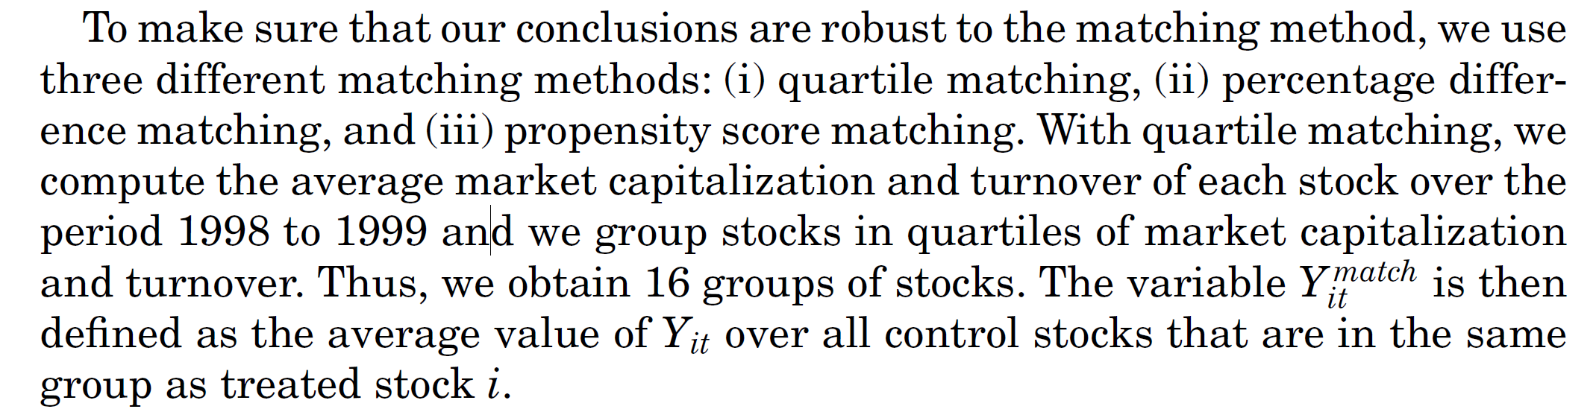
2.4.4.2 Dif in Dif (Matching)
Matching Process
Notes:
参考 UChicago Online，2.5 Fama-MacBeth Regressions

Slide 25
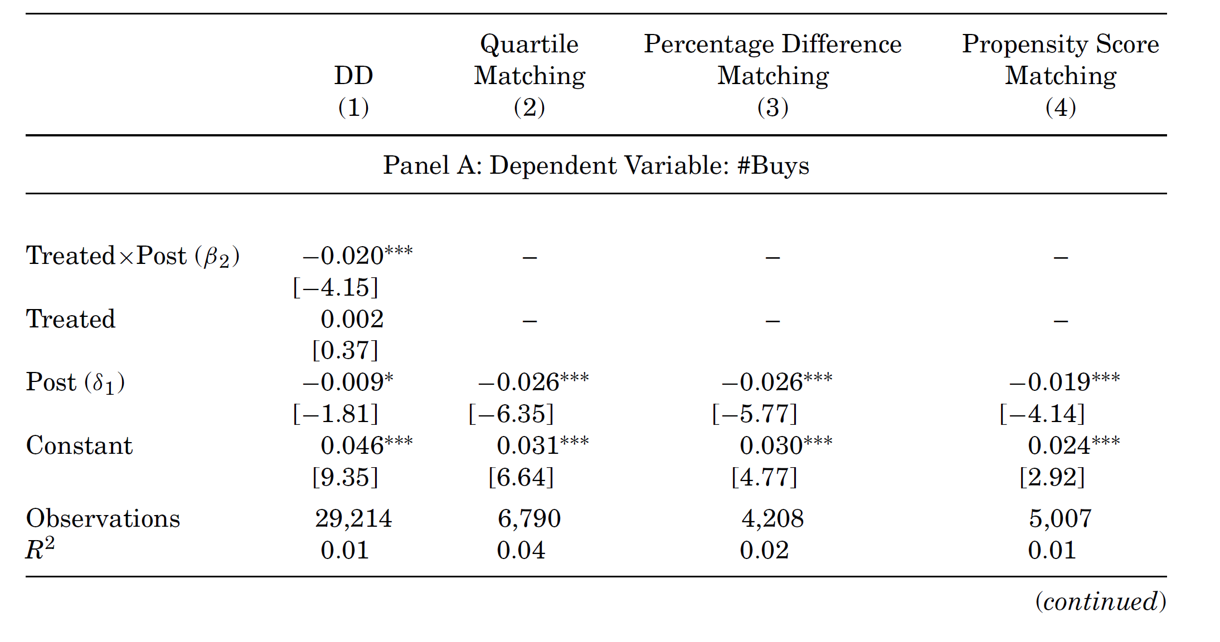
2.4.4.3 Dif in Dif (Individual Trading)

Slide 26
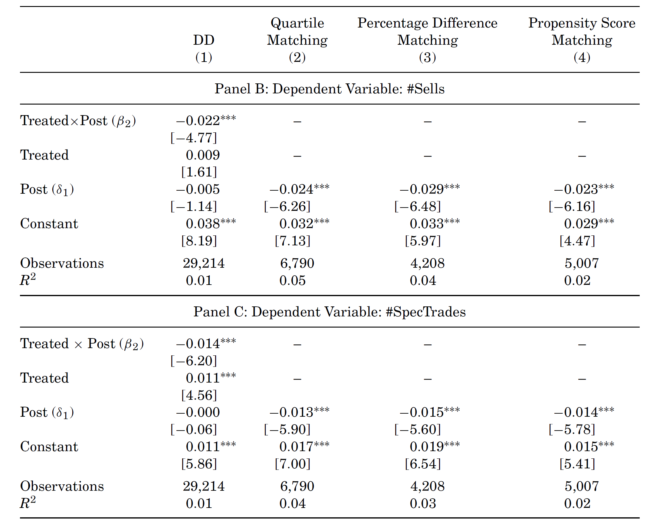
2.4.4.4 Dif in Dif (Individual Trading)

Slide 27
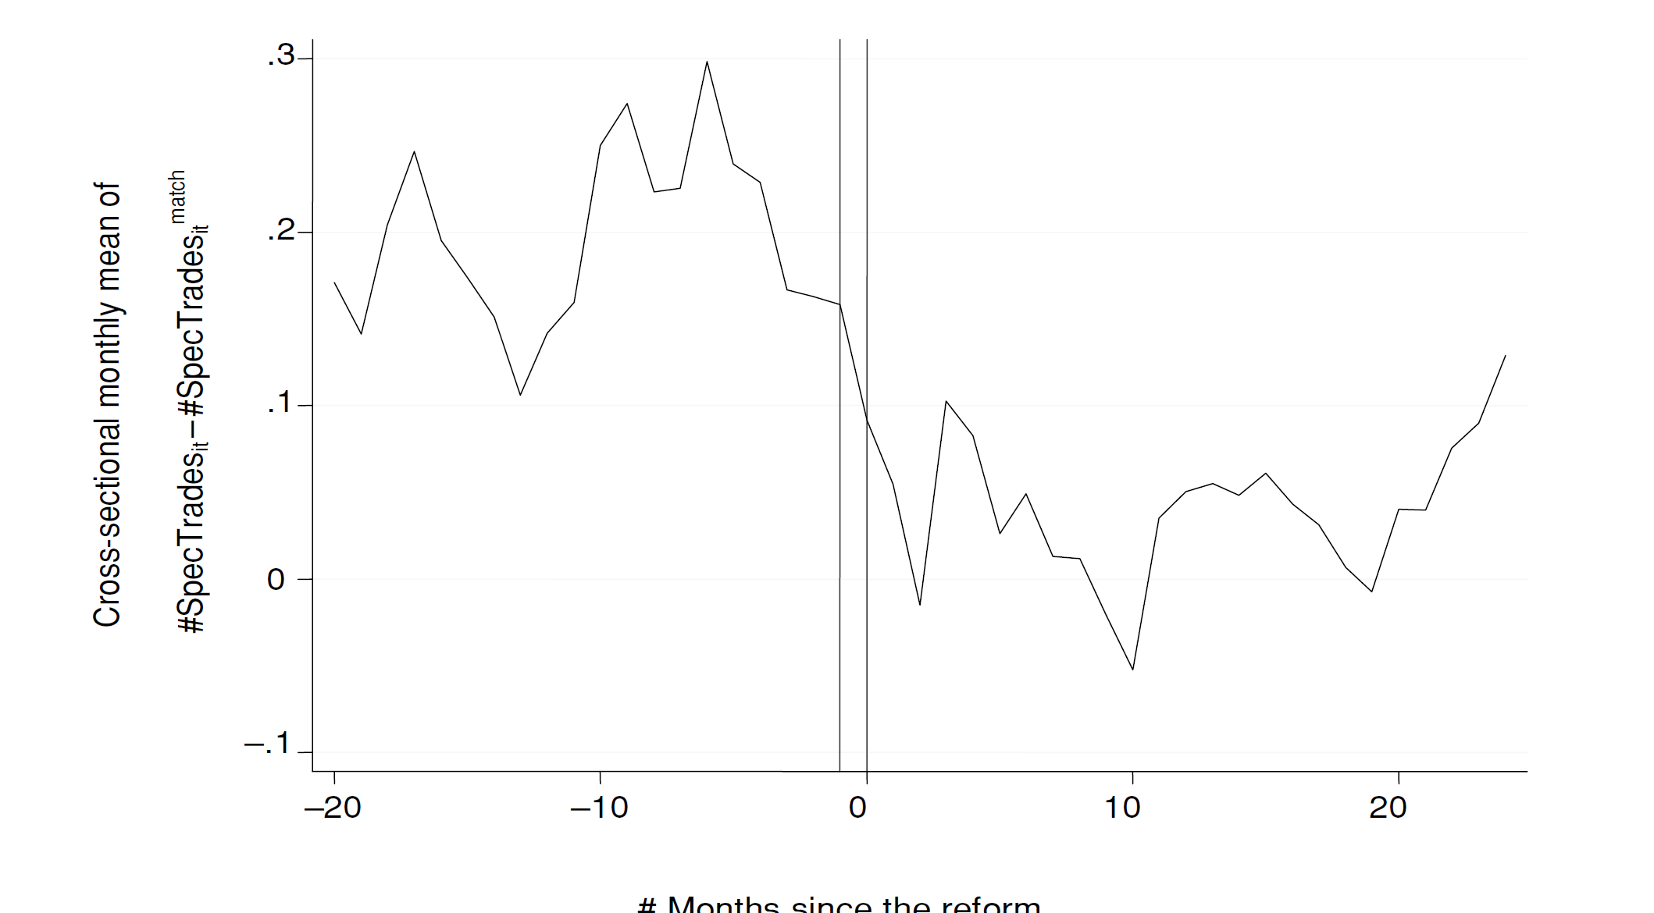
2.4.4.4 Dif in Dif (Individual Trading)

Slide 28
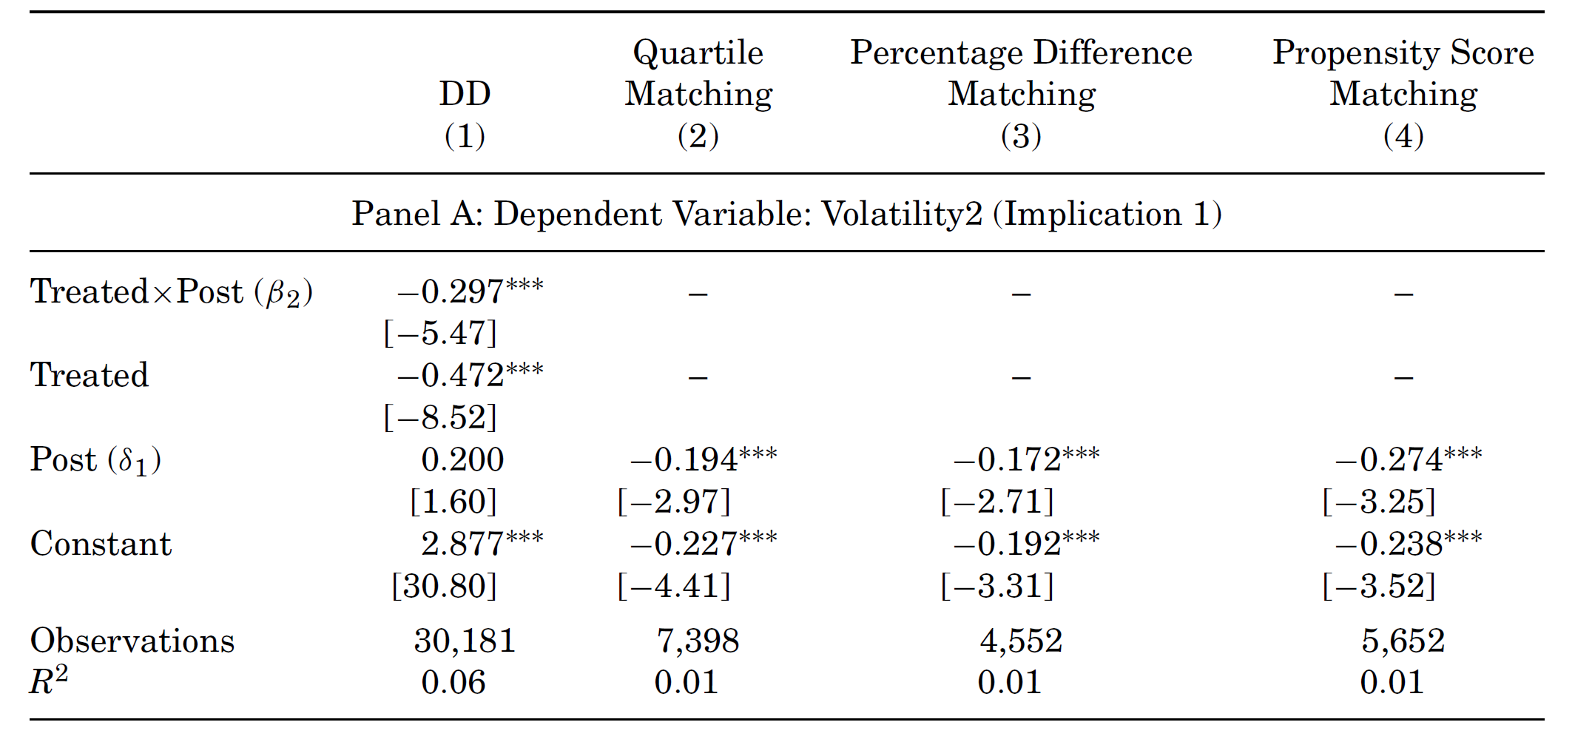
2.4.4.4 Dif in Dif (Vol)

Slide 29
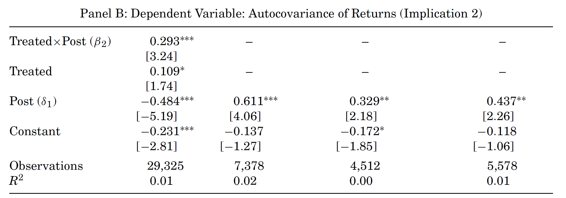
2.4.4.4 Dif in Dif (Auto Vol)

Slide 30
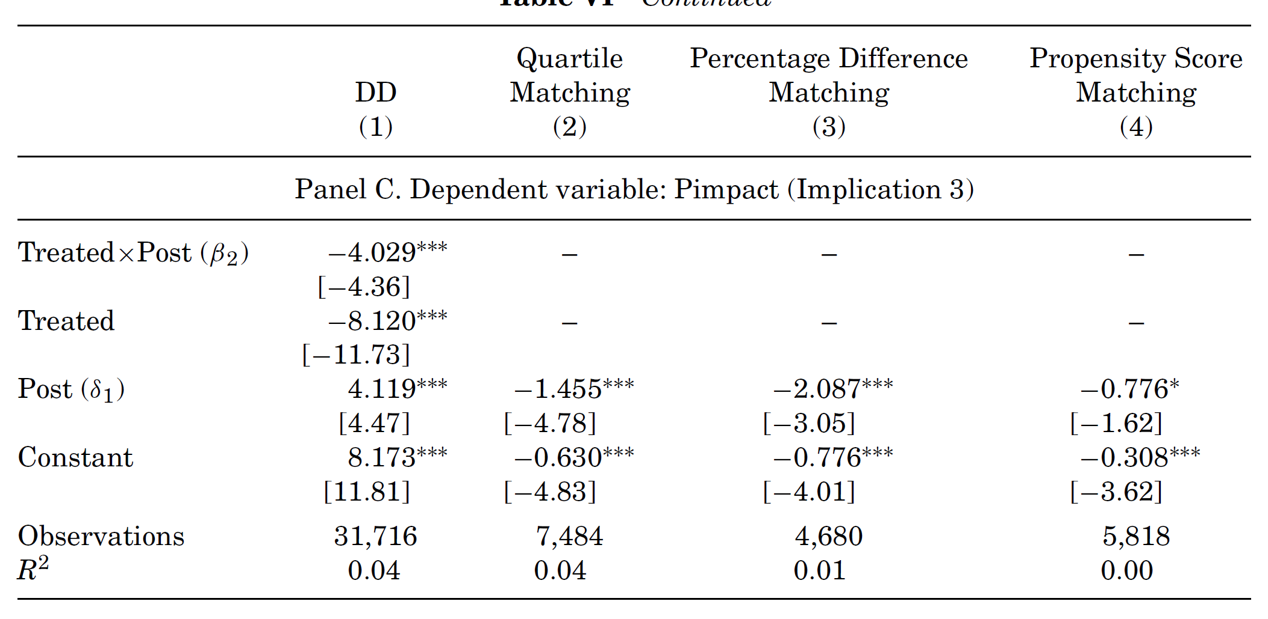
2.4.4.4 Dif in Dif (Price Impact)
They use the monthly average of the daily ratio of the absolute return of a stock divided by its trading volume in euros. This ratio is sometimes called the Amihud measure or the Illiquidity ratio.

Slide 31
oUTLINE
Volatility
Case Study
ARCH-family
ARCH

Slide 32
3.1 definition: ARCH
In econometrics, the autoregressive conditional heteroskedasticity (ARCH) model is a statistical model for time series data that describes the variance of the current error term as a function of the actual sizes of the previous time periods error terms；
The ARCH model is appropriate when the error variance in a time series follows an autoregressive (AR) model;
if an autoregressive moving average (ARMA) model is assumed for the error variance, the model is a generalized autoregressive conditional heteroskedasticity (GARCH) model

Slide 33
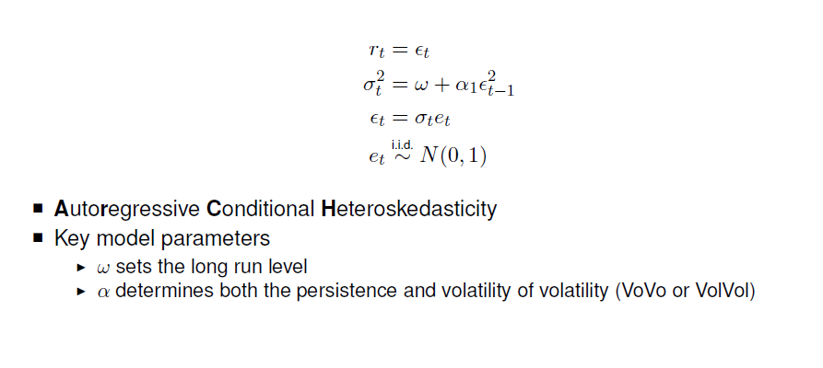
3.1 ARCH(1)

Slide 34
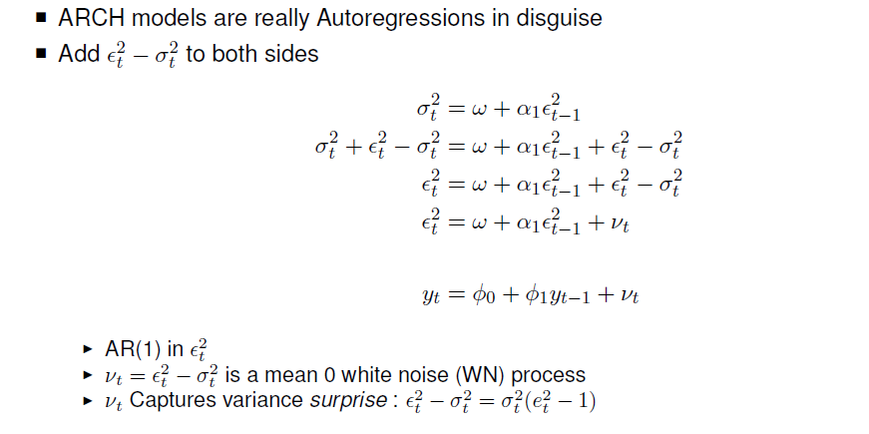
3.1 ARCH(1) and AR (1)

Slide 35
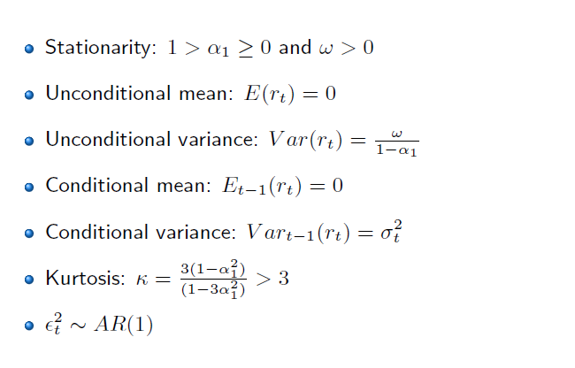
3.1 ARCH(1) property

Slide 36
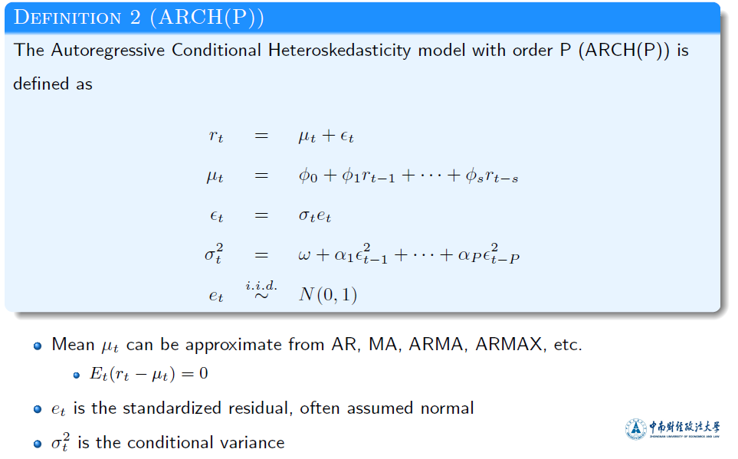
3.2 ARCH(p)

Slide 37
3.3 Testing for “ARCH Effects”
1. First, run any postulated linear regression of the form given in the equation
above, e.g. y_{t} = β₁ + β₂x_{2t} + ... + β_{k}x_{kt} + u_{t}
saving the residuals, .
2. Then square the residuals, and regress them on q own lags to test for ARCH
of order q, i.e. run the regression
where v_{t} is iid.
Obtain R² from this regression
3. The test statistic is defined as TR² (the number of observations multiplied by the coefficient of multiple correlation) from the last regression, and is distributed as a χ²(q).

Slide 38
3.3 Testing for “ARCH Effects”
4. The null and alternative hypotheses are
H₀ : γ₁ = 0 and γ₂ = 0 and γ₃ = 0 and ... and γ_{q} = 0
H₁ : γ₁ ≠ 0 or γ₂ ≠ 0 or γ₃ ≠ 0 or ... or γ_{q} ≠ 0.
If the value of the test statistic is greater than the critical value from the χ² distribution, then reject the null hypothesis.
Note that the ARCH test is also sometimes applied directly to returns instead of the residuals from Stage 1 above.

Slide 39
3.4 Problems with ARCH(q) Models
How do we decide on q?
The required value of q might be very large
Non-negativity constraints might be violated.
When we estimate an ARCH model, we require α_{i} >0 ∀ i=1,2,...,q (since variance cannot be negative)
A natural extension of an ARCH(q) model which gets around some of these problems is a GARCH model.

Slide 40
oUTLINE
Volatility
Case Study
ARCH-family
ARCH

Slide 41
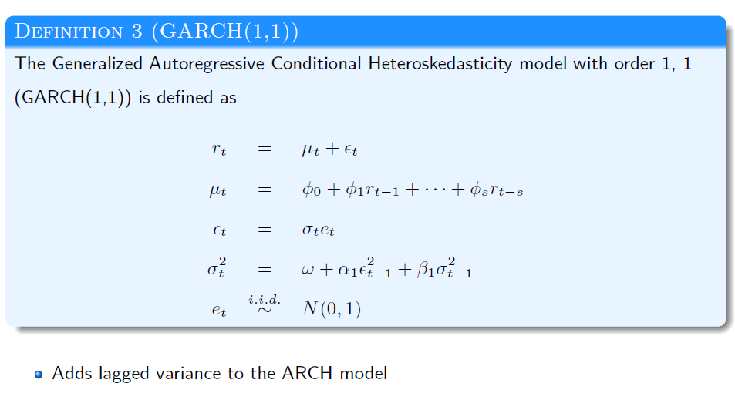
4.1.1 GARCH (1,1)

Slide 42
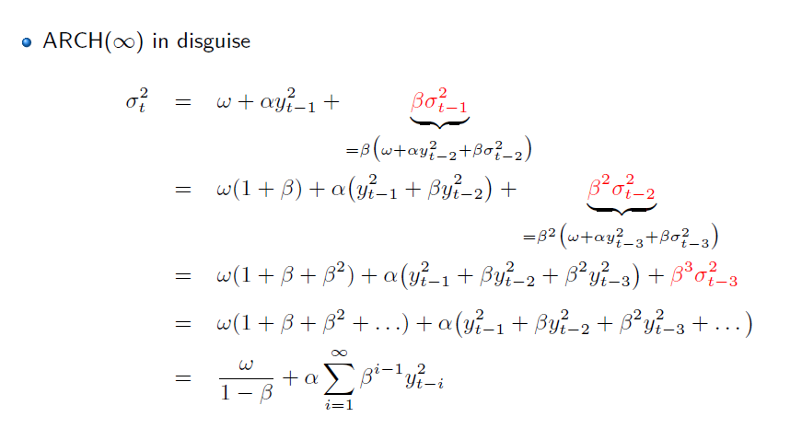
4.1.2 GARCH (1,1) = arch(inf)

Slide 43
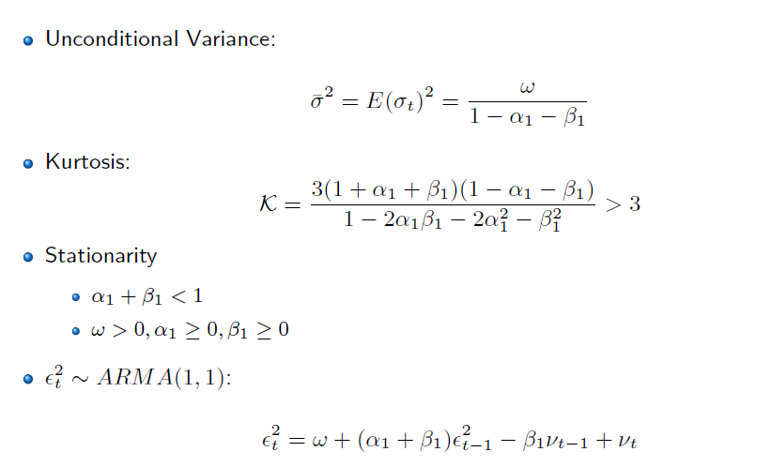
4.1.3 GARCH - property

Slide 44
4.1.3 GARCH - property
In general a GARCH(1,1) model will be sufficient to capture the volatility clustering in the data.
Why is GARCH Better than ARCH?
- more parsimonious - avoids overfitting (the previous page show that a GRACH(1,1) is equivalent to an ARCH(∞), but with only 3 parameters)
- less likely to breech non-negativity constraints

Slide 45
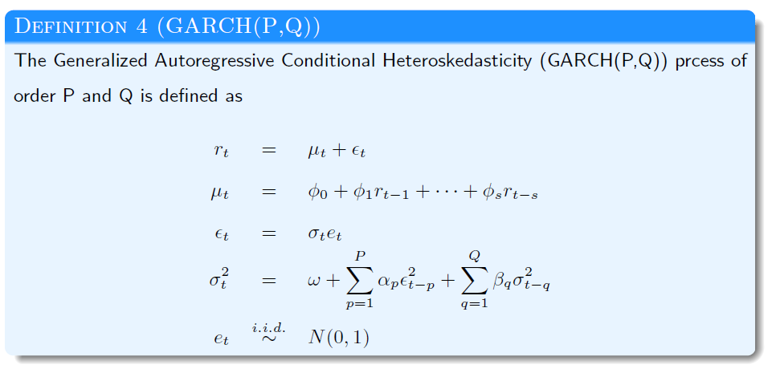
4.1.4 GARCH（P,Q）

Slide 46
Extensions to the Basic GARCH Model
Since the GARCH model was developed, a huge number of extensions and variants have been proposed. Three of the most important examples are EGARCH, GJR, and GARCH-M models.
Problems with GARCH(p,q) Models:
- Non-negativity constraints may still be violated
- GARCH models cannot account for leverage effects
Possible solutions: the exponential GARCH (EGARCH) model or the GJR model, which are asymmetric GARCH models.

Slide 47
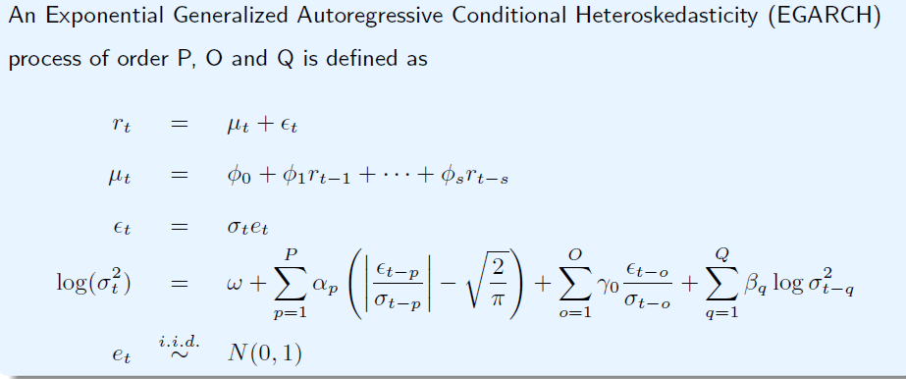
4.2 E-GARCH
Advantages of the model
1 Since we model the log(σ_{t}²), then even if the parameters are negative, σ_{t}² will be positive.
2 We can account for the leverage effect: if the relationship between volatility and returns is negative, γ, will be negative. Volatility can react asymmetrically to the good and bad news.

Slide 48
4.2 E-GARCH(1,1,1)
Suggested by Nelson (1991). The variance equation is given by
Advantages of the model
- Since we model the log(σ_{t}²), then even if the parameters are negative, σ_{t}²
will be positive.
- We can account for the leverage effect: if the relationship between
volatility and returns is negative, γ, will be negative.

Slide 49
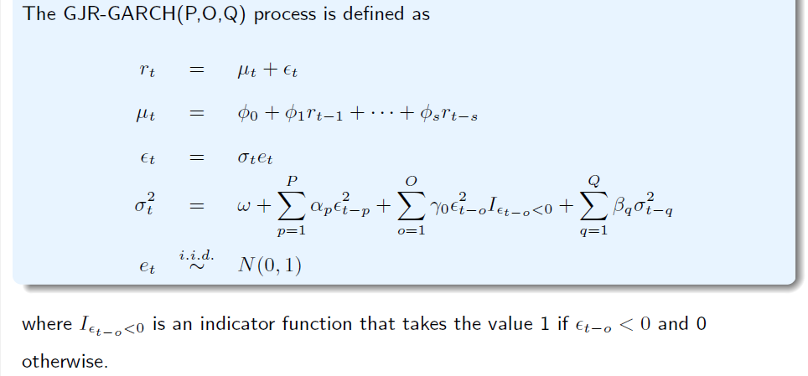
4.3 gjr-GARCH
Glosten, Jaganathan and Runkle

Slide 50
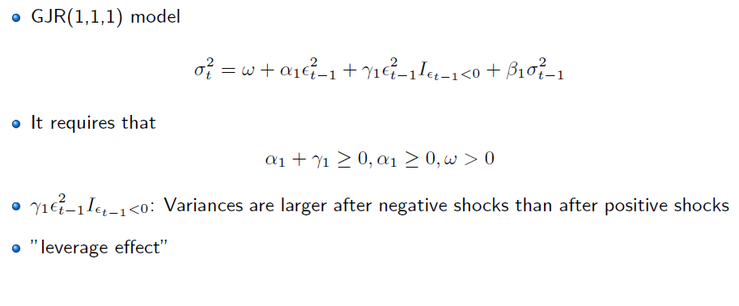
4.3 gjr-GARCH

Slide 51
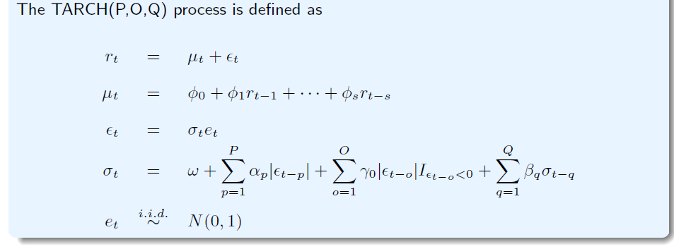


4.4 T-ARCH
Threshold ARCH is similar to GJR-GARCH
Where is an indicator function that takes the value 1 if < 0 and 0 otherwise.

Slide 52
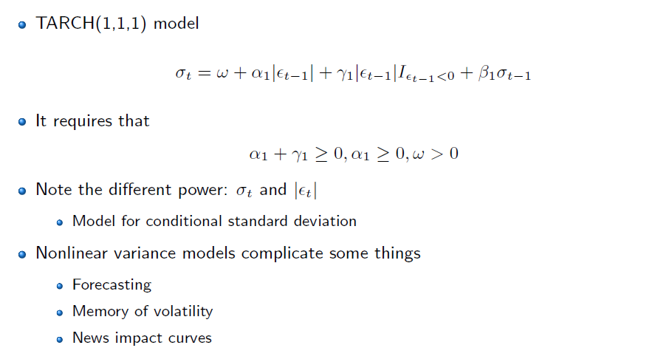
4.4 T-ARCH(1,1,1)

Slide 53
4.5 other – ARCH family
I-GARCH（ Integrated ）
the persistent parameters sum up to one, and imports a unit root in the GARCH process
M-GARCH (GARCH in mean)：
Adds a heteroskedasticity term into the mean equation.
P-ARCH (Higgins and Bera, 1992;power arch)
SA-ARCH(Engle, 1990, simple asymmetric arch)

Slide 54
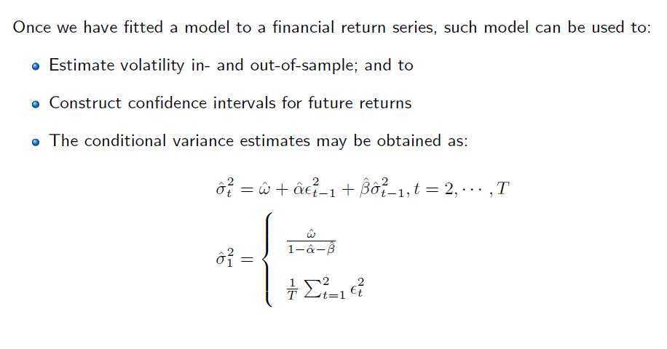
4.6 Forecast

Slide 55
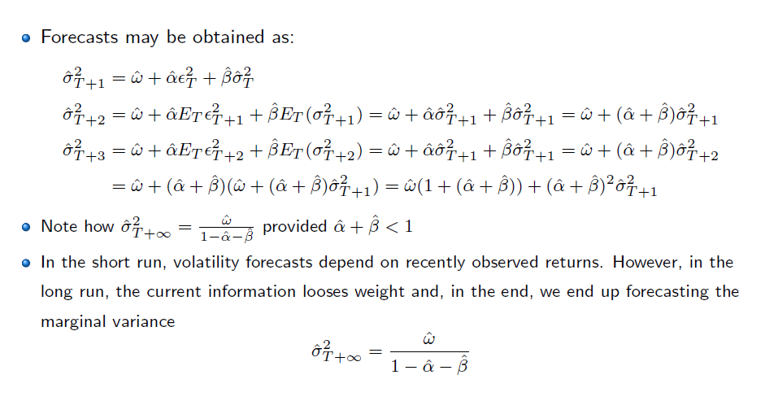
4.6 Forecast

Slide 56
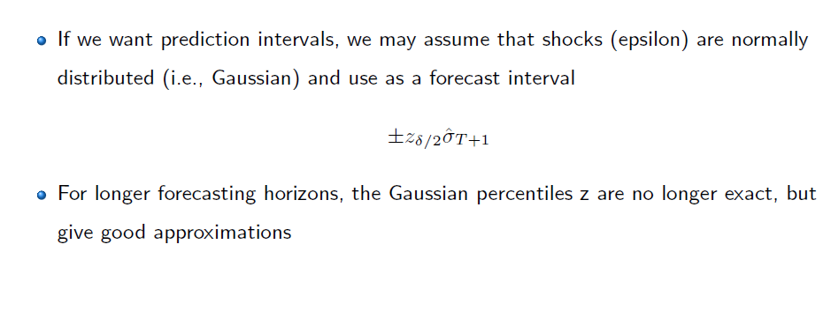
4.6 Forecast

